Slide 1
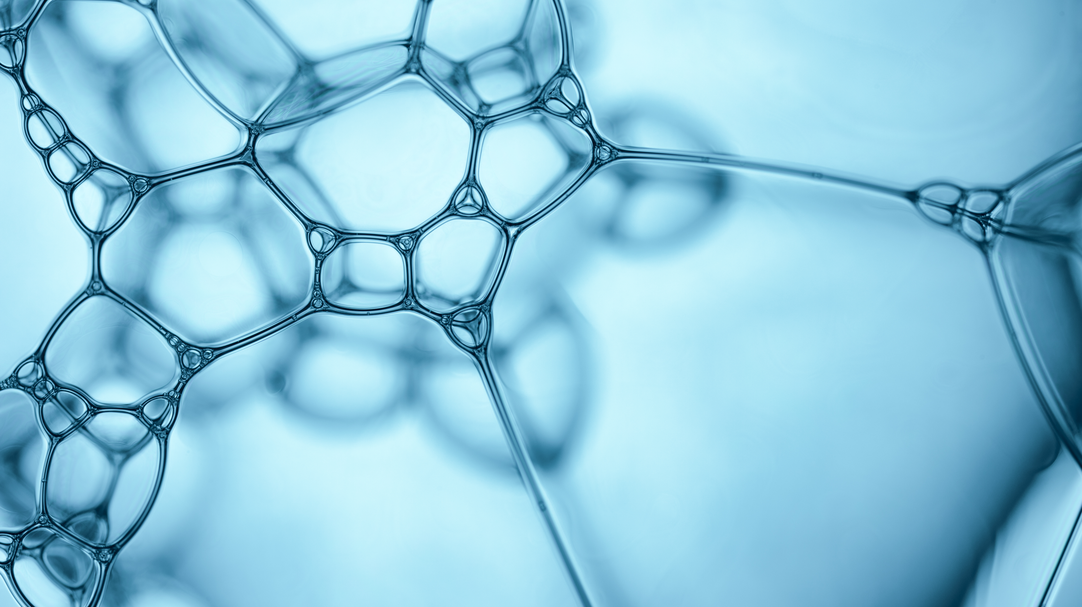
Fisheries Worldwide Personal project
Jan Maciąg
1A
Supervisor – Agnieszka Kulig

Slide 2
Annual fishing and consumption per capita
Every year, people are catching more and more fish from the seas and oceans.
This figure is already reaching 93 million tones by year 2020.
Every minute, 172 tones of fish and seafood are caught (this amount would fill a 120 m2 flat to the ceiling every minute).
The consumption of fish and seafood in year 2020 reached 20.2 kg per person, which is double that of the 1960s.
Consumption per person is estimated to increase to 21.4 kg by year 2030.

Slide 3
The fish and seafood consumption per capita

Slide 4
Countries with the largest marine catches

Slide 5
Fishing indifferent oceans and seas

Slide 6
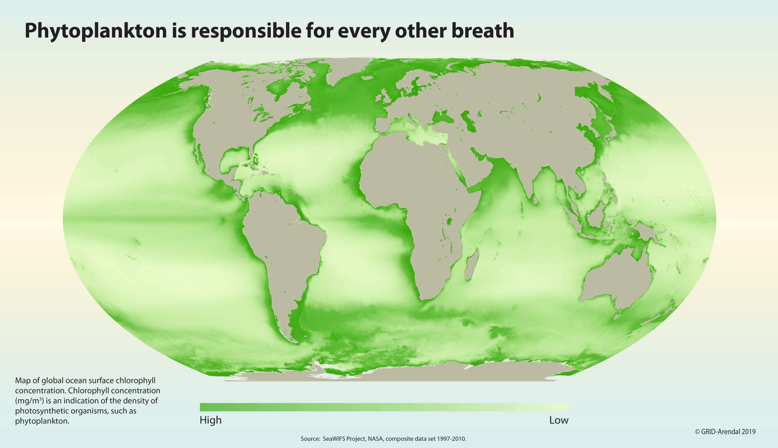
Where are the biggest fiheries worldwide
Shallow well-saturated shelf waters rich in vegetation and plankton (up to 200m depth)

Slide 7
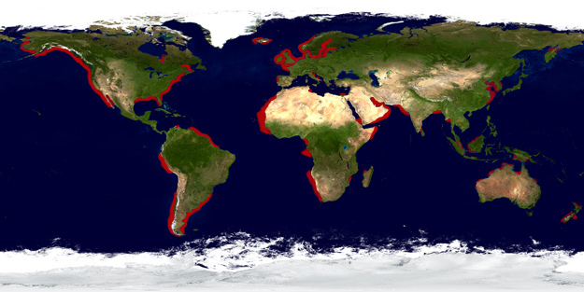
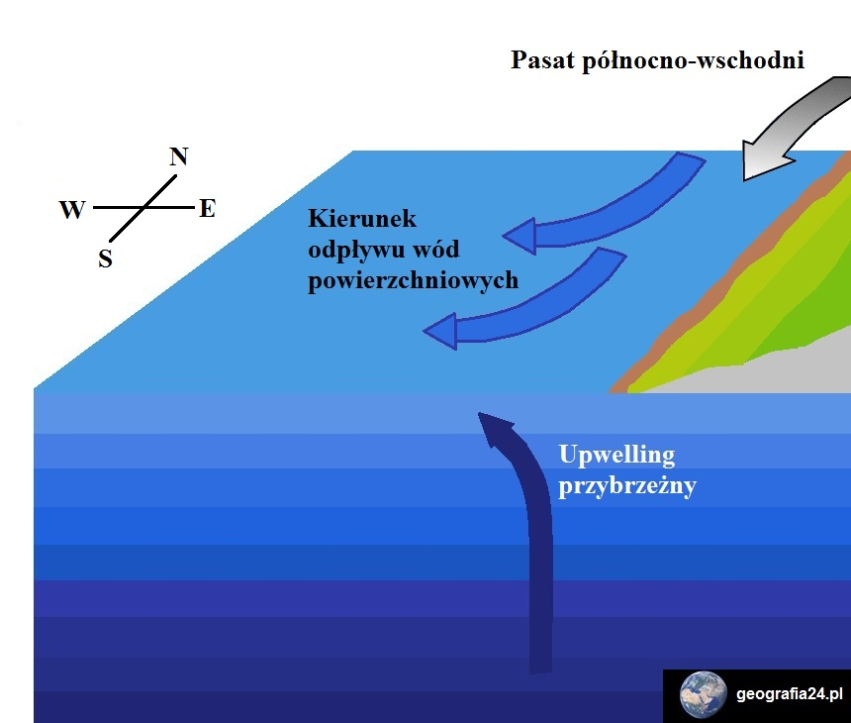
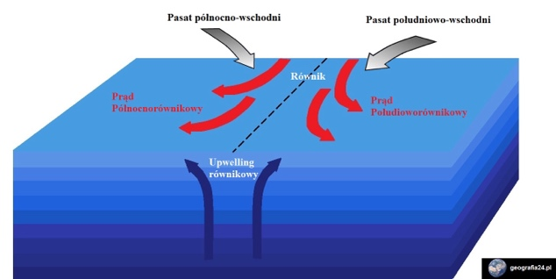
Where are the biggest fiheries worldwide
Upwelling zones
Coastal upwelling of well-oxygenated and nutrient-rich deep waters as a result of a shift in the surface layer of seawater coused bywinds (mainly passat).
In the equatorial zone, equatorial upwelling occurs due to the divergent movement of the North Equatorial and South Equatorial currents. Moving in opposite directions, the currents cause an outflow of water near the equator, allowing deep ocean waters to be uplifted:

Slide 8
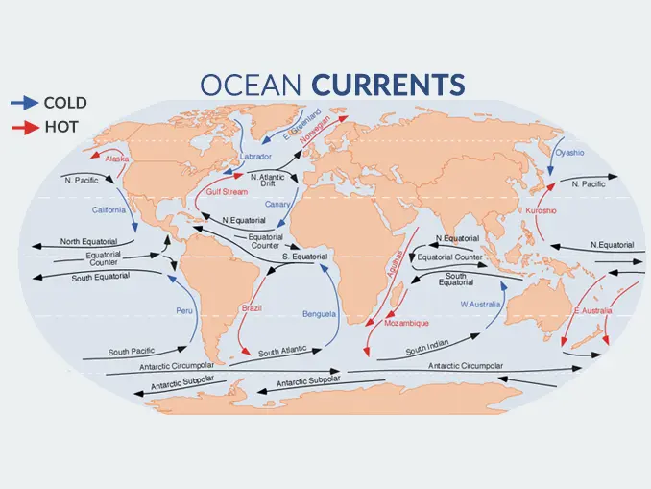
Where are the biggest fiheries worldwide
Places where warm and cold currents meet
it is always at the interface between warm and cold currents that fish have the most favourable conditions for life and function

Slide 9
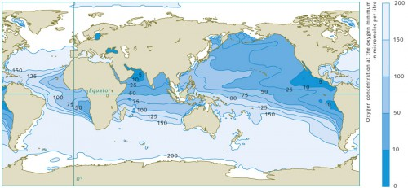
Where are the biggest fiheries worldwide
Cold well-oxygenated waters at high latitudes

Slide 10
The map of world's largest fisheries

Slide 11
Thank you for your attention☺

Slide 12
bibliography
https://zpe.gov.pl/a/przeczytaj/DgwKwfa9L
https://geografia24.pl/ruch_wody_morskiej/
https://odpowiedzialnybiznes.pl/publikacje/the-state-of-world-fisheries-and-aquaculture-2022/https://geografia24.pl/rybactwo-i-akwakultura/
https://zpe.gov.pl/a/przeczytaj/DWf7JZYLL
https://zpe.gov.pl/a/wprowadzenie/DaGLFxyzj
https://zpe.gov.pl/a/przeczytaj/DWf7JZYLL
https://klimatycznabazawiedzy.org/raport/the-state-of-world-fisheries-and-aquaculture-2022/
https://www.gospodarkamorska.pl/ryby-uratuja-swiat-od-glodu-dominuje-azja-i-produkcja-w-krajach-o-srednich-i-niskich-dochodach-68626
https://odpowiedzialnybiznes.pl/publikacje/the-state-of-world-fisheries-and-aquaculture-2022/

Slide 13
Bibliography
https://www.msc.org/docs/default-source/po-files/zrownowazone-rybolowstwo-wieksze-polowy-i-globalne-dostawy-zywnosci-maj-2022.pdf?sfvrsn=d71190de_10
https://www.gov.pl/web/gospodarkamorska/o-rybactwie-srodladowym-i-akwakulturze-w-formacie-miedzynarodowym
https://pan.olsztyn.pl/wp-content/uploads/2021/02/Przeglad-Rybacki-1-2021-ART-KOWALSKI.pdf
https://hydropolis.pl/prady-morskie/
https://www.geografia24.eu/geo_prezentacje_pr_1/301_4_hydrosfera/r1_4_02a.pdf
https://www.na6.pl/geografia/rybolostwo
https://mapsontheweb.zoom-maps.com/image/188629102704
https://studentclimates.wordpress.com/2017/08/17/upwelling-zones-secrets-of-the-deep-ocean/
https://earthhow.com/ocean-currents/
https://worldoceanreview.com/en/wor-1/ocean-chemistry/oxygen/

